Slide 1

STRUCTURED PROGRAMMING
DR. JOSHUA OKEMWA
COMPUTER SCIENCE
DAYSTAR UNIVERSITY

Slide 2
INTRODUCTION
Programming is the process of designing and building an executable computer program to accomplish a specific task or solve a particular problem. It involves writing instructions in a programming language that the computer can interpret and execute.
A programming language is a formal language comprising a set of instructions that produce various kinds of output. Programmers use programming languages to implement algorithms and manipulate data to create software applications.

Slide 3
CONT.
Common approaches in computer programming refer to the various paradigms, methodologies, and practices that developers use to write efficient, maintainable, and scalable code.
1. Procedural Programming:
Description: Focuses on a sequence of procedures or routines (functions) to perform tasks.
Key Concepts: Functions, procedure calls, modularity.
Languages: C, Pascal.

Slide 4
CONT.
2. Object-Oriented Programming (OOP):
Description: Organizes software design around data, or objects, rather than functions and logic.
Key Concepts: Classes, objects, inheritance, polymorphism, encapsulation.
Languages: Java, C++, Python.

Slide 5
Types of Programming Languages:
High-Level Languages:
Python: Known for its readability and simplicity, widely used in web development, data science, artificial intelligence, and scripting.
Java: A versatile, object-oriented language used for building platform-independent applications, web applications, and Android apps.
JavaScript: Primarily used for web development to create interactive and dynamic web pages.
C++: An extension of C, known for its performance and used in system/software development, game development, and real-time simulation.
Ruby: Known for its simplicity and productivity, used in web development (notably with the Ruby on Rails framework).

Slide 6
CONT.
2. Low-Level Languages:
Assembly Language: A low-level programming language that is closely related to machine language and is used for programming hardware and writing performance-critical code.
Machine Language: The most basic programming language, consisting of binary code that the computer's CPU can execute directly.
3. Domain-Specific Languages (DSLs):
SQL (Structured Query Language): Used for managing and manipulating relational databases.
HTML/CSS: Markup and style sheet languages used for creating and designing web pag

Slide 7
Characteristics of Programming Languages:
Syntax: The set of rules that define the structure of valid statements in the language.
Semantics: The meaning of the constructs written in the language.
Abstraction: The ability to define complex operations in simple terms (e.g., functions, classes).

Slide 8
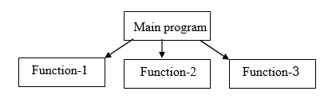
PROCEDURE ORIENTED PROGRAMMING LANGUAGE
In the procedure oriented approach, the problem is viewed as sequence of things to be done such as reading , calculation and printing.
Procedure oriented programming basically consist of writing a list of instruction or actions for the computer to follow and organizing these instruction into groups known as functions.

Slide 9
CHARACTERISTICS OF PROCEDURE ORIENTED PROGRAMMING:
Emphasis is on doing things(algorithm)
Large programs are divided into smaller programs known as functions.
Most of the functions share global data
Data move openly around the system from function to function
Function transforms data from one form to another.
Employs top-down approach in program design

Slide 10
INTRODUCTION TO C LANGUAGE
C is a general-purpose, procedural which is often called a middle level programming language developed by Dennis Ritchie in 1973 at Bell Laboratories.
It is one of the most popular computer languages today because of its structure, high-level abstraction, machine independent feature etc.
It is used to create a system applications that directly interact with the hardware devices such as drivers, kernels, etc.
C programming is considered as the base for other programming languages, that is why it is known as mother language.

Slide 11
Basic Features of C Language
1) Simple
C is a simple language in the sense that it provides a structured approach (to break the problem into parts), the rich set of library functions, data types, etc.
2) Machine Independent or Portable
Unlike assembly language, c programs can be executed on different machines with some machine specific changes. Therefore, C is a machine independent language.
3) Mid-level programming language
Although, C is intended to do low-level programming. It is used to develop system applications such as kernel, driver, etc. It also supports the features of a high-level language. That is why it is known as mid-level language.

Slide 12
Cont.
4) Structured programming language
C is a structured programming language in the sense that we can break the program into parts using functions. So, it is easy to understand and modify. Functions also provide code reusability.
5) Rich Library
C provides a lot of inbuilt functions that make the development fast.
6) Memory Management
It supports the feature of dynamic memory allocation. In C language, we can free the allocated memory at any time by calling the free() function.
7) Extensible
C language is extensible because it can easily adopt new features.

Slide 13
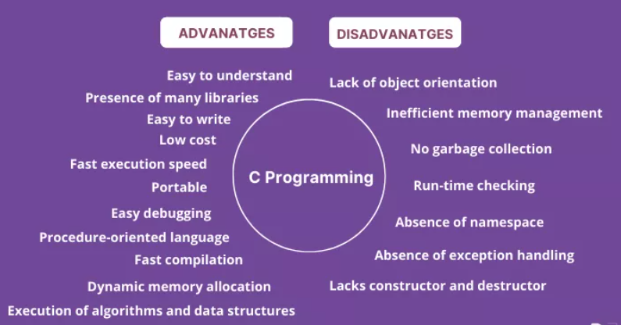
Why C Language?

Slide 14
Getting Started with C Programming
1. Setting Up the Development Environment
Before writing C programs, you need to set up a C development environment on your computer.
Windows:
use an IDE like Code::Blocks, which includes a compiler.
2. Writing Your First C Program
Open a text editor (e.g., VS Code, Sublime Text, or even Notepad).
Write the following code and save it as hello.c:

Slide 15
PROGRAM
#include <stdio.h>
int main()
{
printf("Hello, World!\n");
return 0;
}
3. Compiling and Running Your Program

Slide 16
Compiling a C Program
The compilation is the process of converting the source code of the C language into machine code. As C is a mid-level language, it needs a compiler to convert it into an executable code so that the program can be run on our machine.

Slide 17
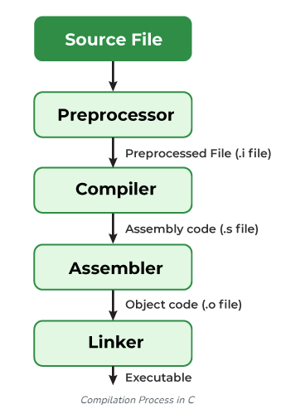
Compiling a C Program

Slide 18
Compiling a C Program
Step 1: Creating a C Source File
We first create a C program using an editor and save the file as filename.c
Step 2: Compiling using any compiler
If there are no errors in our C program, the executable file of the C program will be generated.
Step 3: Executing the program
The program will be executed and the output will be shown in the terminal.

Slide 19
What goes inside the compilation process?
A compiler converts a C program into an executable. There are four phases for a C program to become an executable:
Pre-processing
Preprocessor Directives: The first stage is preprocessing, where the preprocessor handles all the preprocessor directives, such as #include, #define, and #ifdef.
Output: The preprocessed code, which is a modified version of the source code with all directives processed.

Slide 20
CONT.
2. Compilation
Syntax and Semantic Analysis: The compiler parses the preprocessed code to check for syntax and semantic errors.
Intermediate Code Generation: Converts the parsed code into an intermediate representation, often in the form of an abstract syntax tree (AST).
Optimization: Optimizes the intermediate code for performance improvements.
Output: Assembly code.

Slide 21
CONT.
3.Assembly
Assembly Code: The assembly code generated by the compiler is then converted into machine code by an assembler.
Output: Object code (machine code in binary form), usually with a .o or .obj extension.
4. Linking
Combines all object files and libraries.
Resolves function calls and variable references.
Handles static and dynamic linking.
Produces the final executable.

Slide 22
PROGRAM 2
#include <stdio.h>
int main() {
int number1, number2, sum;
printf("Enter two integers: ");
scanf("%d %d", &number1, &number2);
// calculating sum
sum = number1 + number2;
printf("%d + %d = %d", number1, number2, sum);
return 0;
}

